Slide 1
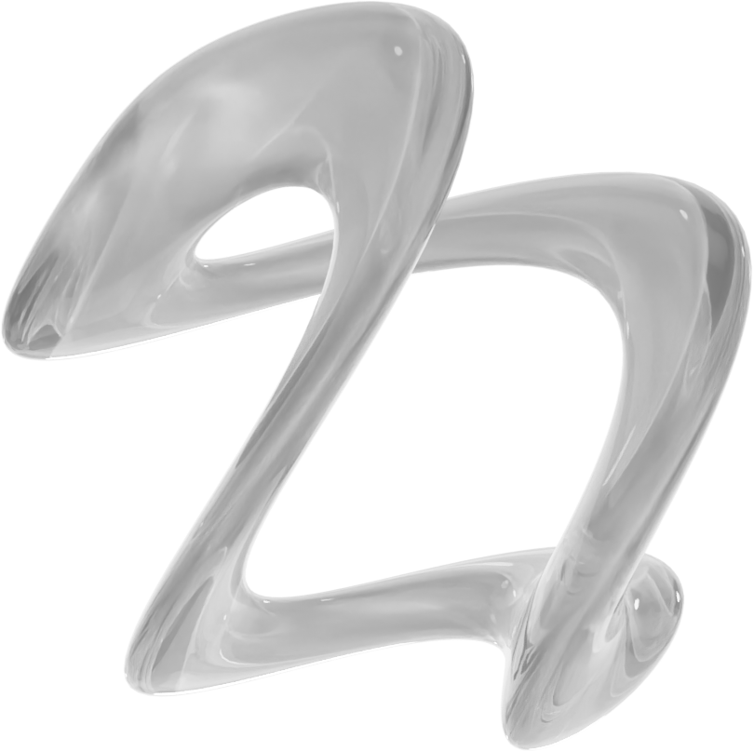

MSBA 2026
The Job Matcher
Presented by
Shahmir Javed, Rizvee Ahmed, Brendan Hendricks, Nathan Arimilli, Pranit Yadav, Sreejony Sengupta

Slide 2


MSBA 2026
Table of Content
THE BUSINESS PROBLEM
THE CHALLENGES
THE SOLUTION
RESULTS & KEY TAKEAWAYS
OUR SYSTEM
CONCLUSION & FUTURE WORK

Slide 3




MSBA 2026
The Business Problem
Job matching is inefficient and inaccurate.
Resumes and job postings are unstructured and hard to compare.
Keyword-based systems miss context and meaning.
This leads to qualified matches or missed opportunities*.
*~75% of resumes never reach a recruiter
Notes:
Hiring platforms today are inefficient. Resumes and job postings are written in unstructured text, full of context and nuance that keyword-based systems can’t capture. This leads to poor matches — candidates who look good on paper but aren’t qualified, or qualified applicants getting filtered out.

Slide 4
MSBA 2026
The Solution
We have built an AI powered Job Matcher that intelligently connects resumes with relevant job postings using natural language processing (NLP).
The system goes far beyond basic keyword searches by understanding context, meaning, and skills in both resumes and job descriptions
Its main goal is to transform unstructured text into structured insights that accurately measure how well a candidate aligns with a specific role.

Slide 5


MSBA 2026
Our System
Our model processes job text through three NLP layers:
TF-IDF | Keyword Weighting
LDA | Topic Patterns
Sentence Embeddings | Semantic Meaning
This enables accurate parsing and matching of candidate qualifications.

Slide 6

Our System: Deep Dive
MSBA 2026
2025
Text Preparation:
The system first cleans and standardizes both resumes and job postings while preserving key technical terms like C++, Python, and SQL to maintain context.
Three Layers of Analysis:
LDA
(Latent Dirichlet Allocation)
Groups related terms into broader topics (for example, data science, finance, or software engineering) to understand thematic overlap.
Sentence Embeddings
Uses transformer-based models to understand semantic meaning, recognizing similarity even when word choices differ.
TF-IDF
Detects the most important and unique words and skills within each document.

Slide 7






MSBA 2026
Our System: Deep Dive
SCORING AND RANKING
QUALIFICATION PARSING
A recently added component extracts structured details from resumes, such as degree level, field of study, years of experience, and technical skills.
This allows the matcher to better determine whether a candidate actually meets the role’s qualifications.
Each method outputs a similarity score.
These are combined into one weighted score that ranks jobs from strongest to weakest match, along with explanations of why a match occurred—such as shared skills, experience, or topics.
Notes:
Hiring platforms today are inefficient. Resumes and job postings are written in unstructured text, full of context and nuance that keyword-based systems can’t capture. This leads to poor matches — candidates who look good on paper but aren’t qualified, or qualified applicants getting filtered out.

Slide 8


MSBA 2026
Initial models over-recommended roles beyond candidate qualifications due to heavy reliance on language similarity.
Adding filters for education and experience thresholds improved match accuracy and user trust.
Limited access to job postings constrained matching accuracy.
Expanding the scraper and database is essential to capture a broader, more representative job pool.
Limited Storage Constraints
The Challenges
Testing revealed some matched roles had expired.
Implementing routine, scheduled scrapes will keep listings fresh and results up to date.

Slide 9
MSBA 2026
2025
Results and Takeaways
Combining classical NLP (TF-IDF and LDA) with modern embeddings created stronger and more interpretable results.
Preserving technical language significantly improved performance for specialized positions.
Topic modeling revealed deeper relationships between resumes and job descriptions that traditional searches miss.

Slide 10

2025
Why It Matters
This project demonstrates the importance of AI in transforming unstructured text into actionable insights, enhancing the hiring process.
By aligning how employers describe job openings with how candidates express their experiences, it ensures better job matches.
This alignment streamlines the job search process, ultimately improving efficiency.

Slide 11
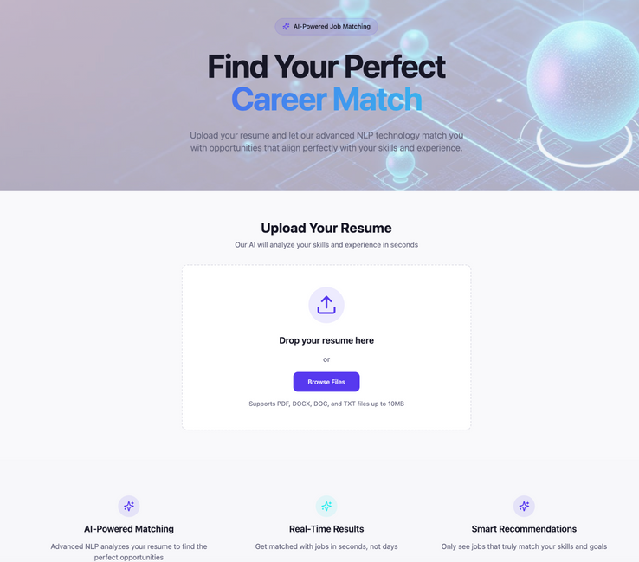
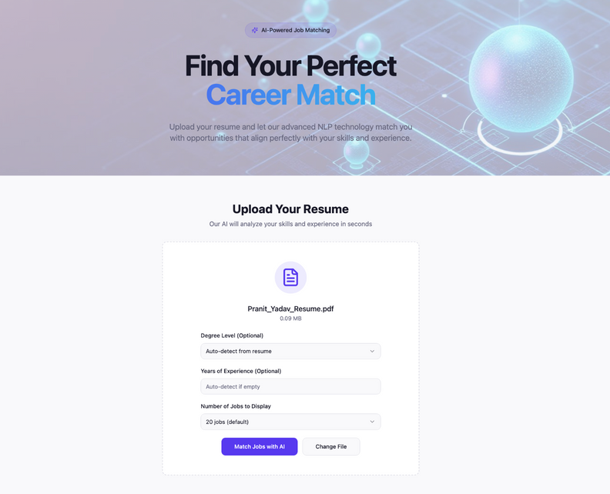
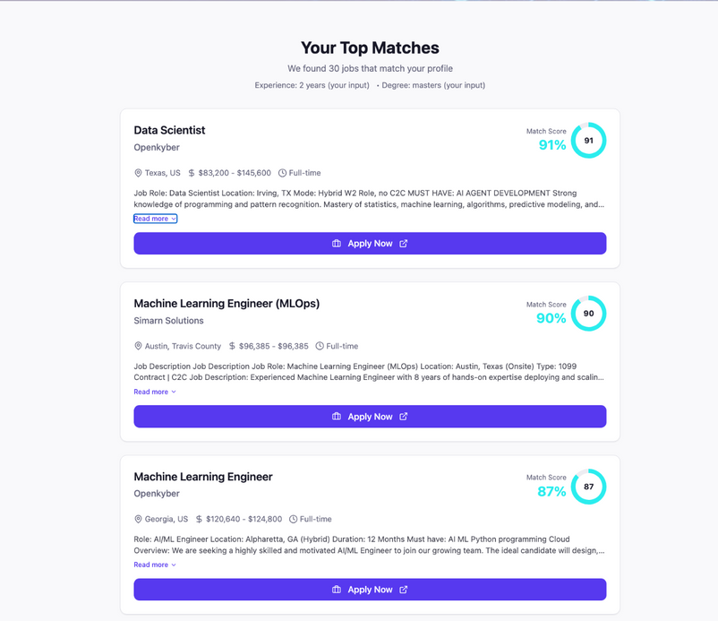
MSBA 2026
2025
Current Work
1
2
3
Building the front end so users can upload resumes, view their matches, and interact with results through a simple, intuitive interface.
Improving the clarity of the explanations provided for each match to make the system easier to interpret.

Slide 12


MSBA 2026
2025
Future Expansions
SMART RECOMMENDATIONS
Help users identify how to strengthen their resumes for specific roles by highlighting missing skills, degrees, or qualifications.
RAG PIPELINE AND JOB DATABASE
Integrate a retrieval-augmented generation pipeline that stores and updates job data automatically through scheduled scraping.
INTERACTIVE FRONT END
Develop a full website and mobile application to make the system more accessible and engaging.

Slide 13






MSBA 2026
2025
Future Expansions
SCRAPER EXPANSION
Extend our scraping tools to include additional job boards and industries for broader coverage.
USER TESTING
Collect feedback from real users to refine accuracy and usability.
USER ACCOUNT CREATION
Maintain a privacy-first design to store secure user data and ensure that no resumes are leaked, and that future versions include local-only data processing and anonymization.

Slide 14

MSBA 2026
Thank You

